Slide 1
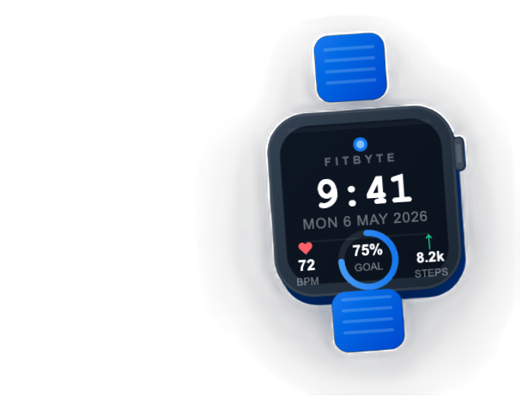
FitByte
AI Content Creator
Brand-aligned content generation powered by dual knowledge bases
Adi, Gunther, Markus
Ironhack Data Analytics Bootcamp • Module 2 Project
May 2026

Slide 2
01 — PROBLEM & SOLUTION
What Problem Does It Solve?
THE PROBLEM
THE SOLUTION
▸
Generic AI content looks and sounds the same
▸
Dual knowledge base: brand guidelines + market research
▸
ChatGPT has no brand voice, no product knowledge
▸
5-stage pipeline: Document → Monitor → Brief → Publish → Iterate
▸
Content teams lack a scalable, consistent system
▸
Dynamic prompt templates injected with proprietary context
▸
AI outputs ignore market positioning & competitor gaps
▸
Human-in-the-loop for quality control & iteration
Target Audiences:
Performance Athletes
Fitness Enthusiasts
Health Professionals
Upgraders
Target Channels:
Blog Post
LInkedIn
Instagram Caption
Email Subjects
2

Slide 3
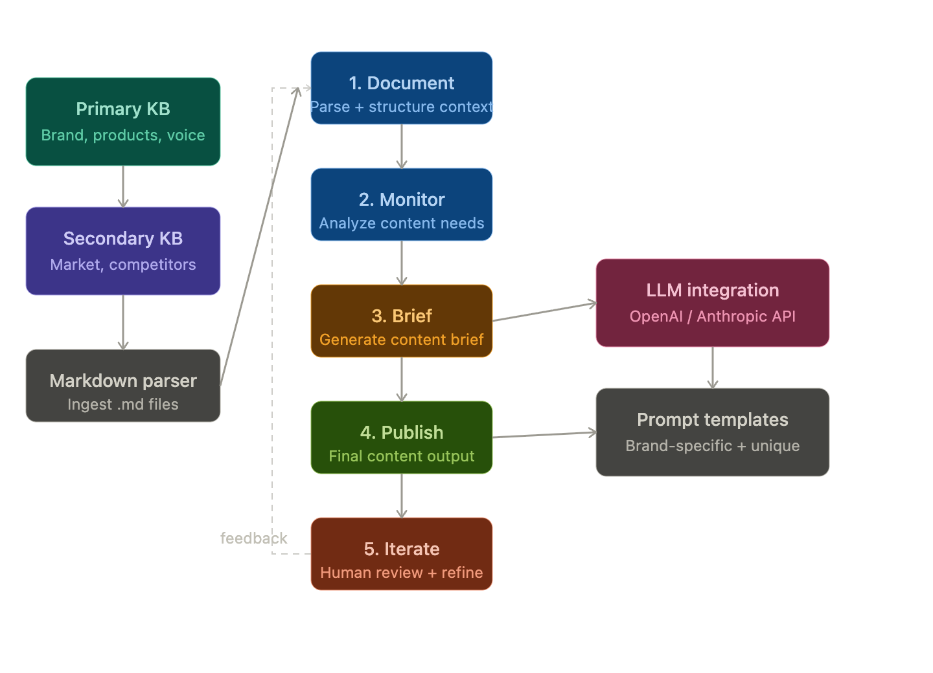
02/03 — KNOWLEDGE BASE & CONTENT PIPELINE
5-Stage Content Creation Pipeline
4

Slide 4
04 — UNIQUENESS DEMONSTRATION ⭐ CRITICAL
Examples updated
FitByte vs Generic ChatGPT
Topic: "Sleep quality and recovery" | Audience: Performance Athlete | Channel: Blog
FITBYTE BRANDED OUTPUT
GENERIC CHATGPT OUTPUT
**Sleep Quality and Recovery: The Unsung Heroes of Performance**
It is not just about clocking hours in the gym. For athletes and everyday movers alike, sleep quality plays a crucial role in recovery and overall performance. A single night of restless sleep can hinder your progress, affecting everything from muscle repair to mental sharpness.
Recent insights show that many serious athletes are now prioritizing recovery metrics, with 68 percent tracking their recovery more closely than ever. This shift reflects a growing awareness that quality sleep often trumps quantity. Six hours of restorative sleep can be far more beneficial than eight hours of tossing and turning.
At FitByte, we understand the importance of this balance. Our fitness watch not only tracks your activity but also monitors your sleep stages, providing insights into how well you rest at night. With features like heart rate variability tracking, you can better understand your body’s readiness to tackle the day ahead.
So, if you want to maximize your performance, consider your sleep as a vital component of your training plan. Prioritize rest, listen to your body, and let the data guide you towards smarter recovery. Your next workout will thank you for it.
Improving Your Sleep Quality Sleep quality is one of the most important parts of recovery. While workouts, nutrition, stretching, and recovery tools can help, sleep is when your body does most of its repair work. During deep sleep, muscles rebuild, energy stores are restored, and hormones that support growth, appetite, and stress are regulated.
Good sleep also supports mental recovery. REM sleep helps with memory, mood, focus, and emotional balance. When sleep is poor, you may feel more irritable, less motivated, slower to recover, and more likely to experience cravings, low energy, or weaker performance.
Improving sleep quality does not need to be complicated. Try keeping a consistent bedtime and wake-up time, getting natural light early in the day, limiting caffeine later in the afternoon, and creating a cool, dark, quiet bedroom. A short wind-down routine before bed can also help signal to your body that it is time to rest.
Better recovery starts with better sleep. When you sleep well, your body repairs faster, your mind feels clearer, and your energy becomes more stable throughout the day.
VS
FitByte advantages:
Brand voice
Specific product refs
Real data (68% stat)
Audience insight
6

Slide 5
06 — TECHNICAL IMPLEMENTATION & PROMPT ENGINEERING
Architecture & Dynamic Prompts
llm_integration.py
document_processor.py
knowledge_base.py
GPT-4o-mini + Claude Haiku
Auto-provider detection
Exponential backoff & token tracking
Markdown parsing
Text extraction & cleaning
Structured context dict
Primary & secondary KB
Unified context builder
Audience-aware filtering
prompt_templates.py
content_pipeline.py
app.py (Gradio UI)
PromptContext dataclass
Channel-specific builders
NO_EM_DASH anti-AI rules
Orchestrates all 5 stages
Batch mode + uniqueness runner
OutputManager saves files
Web interface + gr.State JSON
Live streaming output
Channel / audience selector

Slide 6
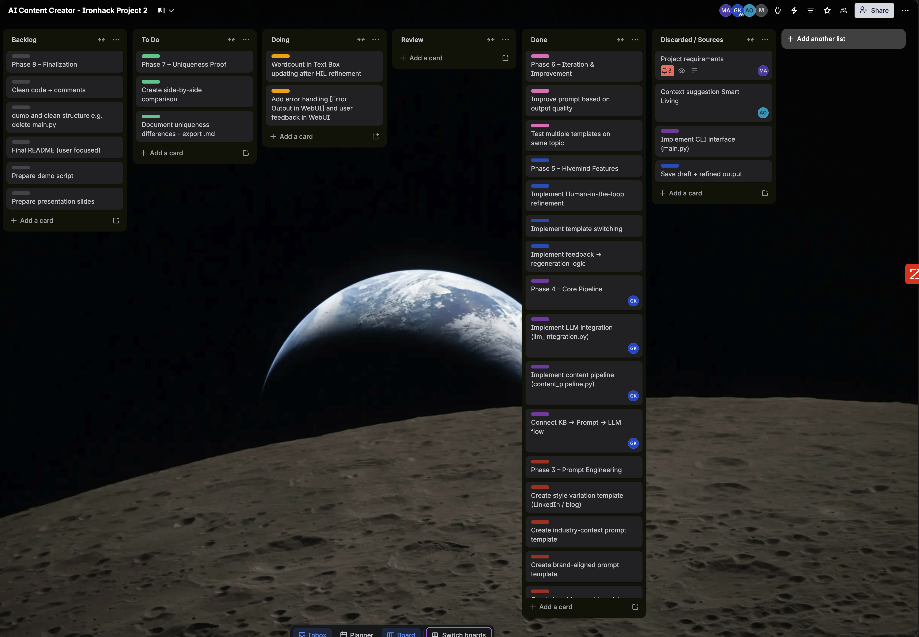
05 — Kanban Board
Placeholder for Trello
How we worked together

Slide 7
0/087 — CHALLENGES & LEARNINGS & NEXT STEPS
What We Learned — Where We're Headed
CHALLENGES & LEARNINGS
NEXT STEPS
Generic Outputs
RAG / Vector Retrieval
Future Module
EM Dash Overuse
Advanced Monitoring
Next Sprint
Shallow Content
Automated Publishing
Phase 2
Voice Leakage
Multi-Brand Support
Phase 3
Key Learning: Uniqueness comes from specific CONTEXT, not better prompts. Depth of knowledge base = depth of content differentiation.

Slide 8
Thank You
Questions?
How did you ensure content uniqueness?
Knowledge base organization & structure
Prompt engineering techniques used
Why 5 pipeline stages vs 1 direct call?
Technical choices: OpenAI vs Anthropic
Kanban workflow & WIP limits
Built for Ironhack Data Analytics Bootcamp — Module 2 Project — May 2026
11

Slide 9
ARCHIVE

Slide 10
02 — KNOWLEDGE BASE ARCHITECTURE
Two-Layer Knowledge System
PRIMARY KNOWLEDGE BASE
SECONDARY RESEARCH LAYER
fitbyte_brand_guidelines.md
market_trends.md
• Brand voice rules (active voice, no serial comma)
• 2024-2025 consumer fitness trends
• 4 audience personas with tone guides
• 68% of serious athletes track recovery metrics
• Channel-specific writing standards
• Wearables market growth trajectory
fitbyte_product_specs.md
competitor_analysis.md
• 14-day battery, dual-frequency GPS
• Garmin, Apple Watch, Fitbit, Whoop positioning
• 6-stage sleep tracking, Recovery Score
• FitByte differentiators identified
• SpO2, VO2 max, 50m water-resistance
• Pricing & feature gap analysis
past_content/fitbyte_content_examples.md
• 10 real FitByte blog posts
• Few-shot style reference
• Proven brand-aligned tone
Primary = What FitByte IS | Secondary = What the MARKET looks like
3

Slide 11
03 — CONTENT PIPELINE
Version 1
5-Stage Content Creation Pipeline
1
DOCUMENT
2
MONITOR
3
BRIEF
4
PUBLISH
5
ITERATE
Load & structure brand + market context from both KBs
LLM analyzes topic for brand fit & market relevance
Chain-of-thought prompt generates structured content brief
Few-shot + contextual placement generates final content for target channel
Human review: approve / edit / regenerate (Human-in-the-Loop)
▶
▶
▶
▶
python main.py --topic "why rest days matter" --channel blog --audience fitness_enthusiast
4

Slide 12
04 — EXAMPLE OUTPUT
Generated Content — Blog Post
TOPIC
CHANNEL
AUDIENCE
PROVIDER
How Training Load Prevents Injuries
Blog
Performance Athlete
OpenAI GPT-4o-mini
GENERATED OUTPUT
✓ Saved to /outputs/
Why Training Load Management is Your Best Defense Against Injuries Did you know that the right training load can be your best defense against injuries? Performance athletes often push their limits, but without understanding training load, they risk injury and burnout. FitByte's Recovery Score transforms complex data into one actionable number — telling you when to push harder and when to ease off. Athletes who manage their training loads report fewer injuries and improved overall performance. 68% of serious athletes now track recovery metrics. FitByte's dual-frequency GPS and 14-day battery keep you informed across every session. Ready to take control? Start tracking your training load today.
5

Slide 13
05B — HUMAN-IN-THE-LOOP EVALUATION
Iterative Refinement System
Test 1
Add Metrics
Test 2
Length Control
Test 3
Context Injection
Test 4
Combined
Human Input:
Human Input:
Human Input:
Human Input:
add metrics as proof
Shorten it to X words
tie it to the upcoming Ironman
add metrics + 350 words + Ironman context
Result:
Result:
Result:
Result:
Metrics added consistently Increased credibility Content shifts: generic → evidence-based
Model compresses well Maintains core message Channel-specific optimization
Content becomes scenario-specific Stronger emotional relevance Generic fitness → endurance focus
Increased depth & structure Natural metric integration Strong contextual anchoring
Key Finding: Context injection is the most powerful lever for uniqueness. Human iteration is essential — not optional.
6B

Slide 14
Placeholder for Trello

Slide 15
07 — CHALLENGES & LEARNINGS
What We Faced — What We Learned
Generic Outputs
EM Dash Problem
Challenge:
Initial content was indistinguishable from vanilla ChatGPT
Challenge:
LLMs default to em-dash overuse — a strong "AI-writing" signal
Solution:
Deep KB injection into every prompt + few-shot style examples forced brand anchoring
Solution:
Added NO_EM_DASH_RULE to all system prompts; tested across 10+ outputs to verify removal
Prompt Chaining
Consistency Across Channels
Challenge:
Single-step prompts produced shallow content without strategic angle
Challenge:
Blog voice leaked into Instagram; LinkedIn felt too casual
Solution:
Added BRIEF stage before PUBLISH: forced angle + hook + insight before generating final content
Solution:
Built separate prompt builders per channel with strict character/tone/structure rules
Key Learning: Uniqueness comes from specific CONTEXT, not better prompts. Depth of knowledge base = depth of content differentiation.
9

Slide 16
08 — NEXT STEPS
Future Improvements
RAG / Vector Retrieval
Future Module
Future Module
Replace flat markdown loading with semantic vector search. Retrieves only the most relevant KB chunks per topic — not required for Project 2, planned for future module.
Advanced Monitoring
Next Sprint
Next Sprint
Track content performance metrics: engagement rates, A/B comparison, auto-scoring against brand guidelines on every generation.
Automated Publishing
Phase 2
Phase 2
Direct API publishing to Instagram, LinkedIn, email platforms. Approval workflow with one-click scheduling.
Multi-Brand Support
Phase 3
Phase 3
Parameterize the KB structure to support multiple brands/clients. Turn FitByte into a white-label content platform.
10

Slide 17
07 — CHALLENGES & LEARNINGS · 08 — NEXT STEPS
Version 1
What We Learned — Where We're Headed
CHALLENGES & LEARNINGS
NEXT STEPS
Generic Outputs
RAG / Vector Retrieval
Future Module
⚠ Initial content was indistinguishable from vanilla ChatGPT
Replace flat markdown loading with semantic vector search — retrieves only the most relevant KB chunks per topic.
✓ Deep KB injection + few-shot style examples forced brand anchoring
EM Dash Overuse
⚠ LLMs default to em-dashes — a clear AI-writing signal
Advanced Monitoring
Next Sprint
✓ Added NO_EM_DASH_RULE to all system prompts; verified across 10+ outputs
Track engagement rates, A/B comparisons, and auto-score content against brand guidelines on every generation.
Shallow Content
⚠ Single-step prompts lacked strategic angle or hook
Automated Publishing
Phase 2
✓ Added BRIEF stage before PUBLISH to force angle + insight first
Direct API publishing to Instagram, LinkedIn, and email. One-click approval workflow with scheduling.
Voice Leakage
⚠ Blog tone bled into Instagram; LinkedIn felt too casual
Multi-Brand Support
Phase 3
✓ Built separate prompt builders per channel with strict tone/structure rules
Parameterize the KB to support multiple brands. Turn FitByte into a white-label AI content platform.
Key Learning: Uniqueness comes from specific CONTEXT, not better prompts. Depth of knowledge base = depth of content differentiation.

